Slide 1
A visible instrument for interferometry
MASSIVE STARS
by Ph. Stee
Massive Stars sub-group:
Borges Fernandes Marcelo
Carciofi Alex
de Wit Willem-Jan
Domiciano de Souza Armando
Faes Daniel
Kostogryz Nadia
Meilland Anthony
Millour Florentin
Nardetto Nicolas

Slide 2
Massive Stars: Topics
Stellar surface studies: diameters, fast rotation, flattening, gravity darkening, differential rotation…
Multiplicity: Characterization of multiple systems, interactions between components…
Circumstellar environments: geometry and kinematics, mass flux determination, surface/disk interface…

Slide 3
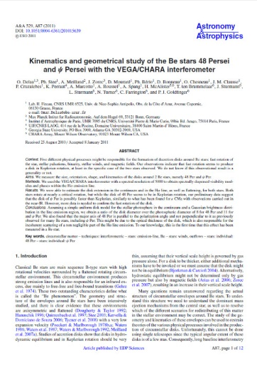
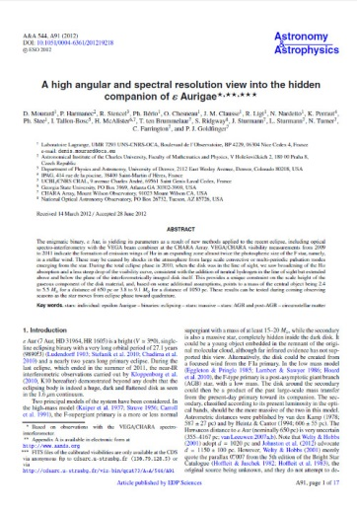
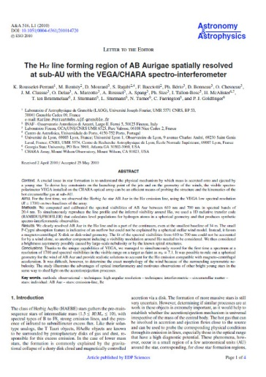
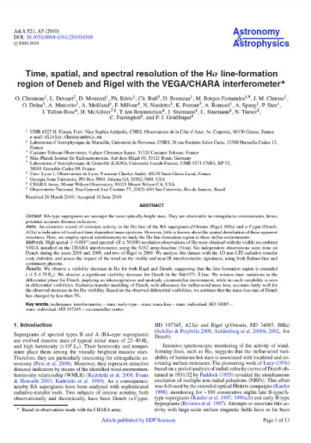
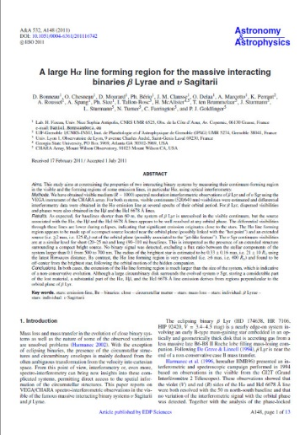
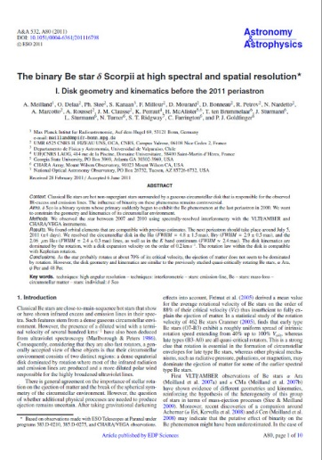
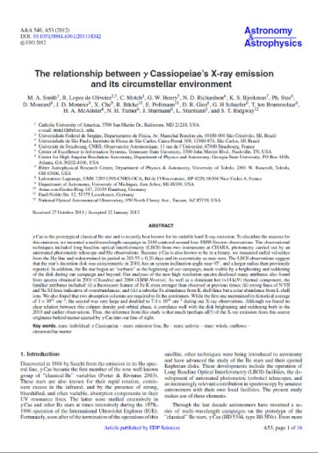
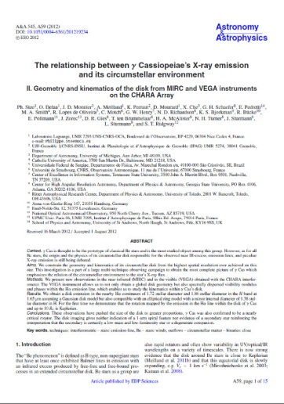
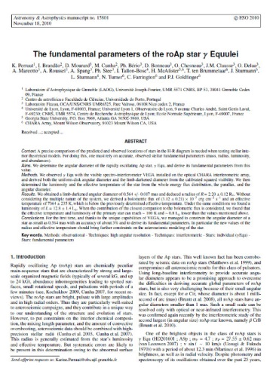
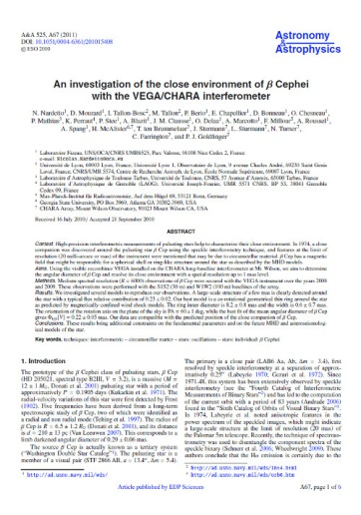
Massive Stars: Scientific production
A very productive topic: 14 papers are about massive/hot stars for a total of 24 VEGA papers
10 papers on the geometry & kinematics of the circumstellar environment mainly in Hα: (AB Aur, Deneb & Rigel, 48 Per & ψ Per, β Lyr & υ Sgr, δ Sco, γ Cas, ε Aur, HD 200775)
1 paper on a diameter measurement
(γ Equ)
1 paper on the geometry in the continuum
(δ Cep)

Slide 4
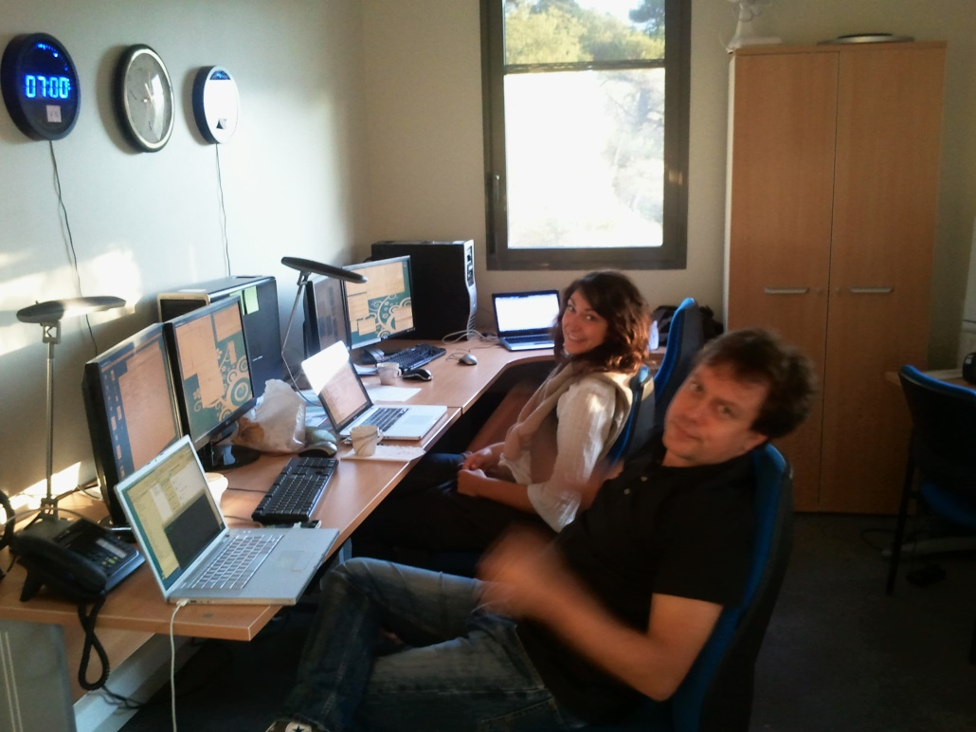
Massive Stars: VEGA Targets
In 2013: 10 programs on VEGA were about massive stars (50%)
In 2014: 9 programs among 17 (1 on multiplicity (eclipsing binaries, ε Aurigae, SS Lep), 4 on stellar surfaces (Bn, HD177724, HD209409, ω Ori) , 4 on circumstellar environments (ω Ori, 51 Oph, HD141569, Hypergiants)
VEGA remote observations

Slide 5
VEGA actual limitations
Magnitude limitation
(u,v) plane coverage
Maximale Resolution D = 0.5 mas (B = 330 m)
Limited for extended objects( > 2 mas)
No compact triplet on CHARA
Not possible for D > 5.5 mas (B = 30 m)
V=3.5 (HR)
B2V à 200 pc
D*= 0.25 mas
D_{env} = 2.5 - 5 mas
VEGA on CHARA
Not very well optimised for the study of circumstellar environments
Detector problems
« scaling » of spectra
Saturation for bright objects
Filters ⬄ loss of SNR
Other limitations
Reduced SNR in the blue
No phase closure

Slide 6
Massive Stars: Stellar Surfaces
Diameters measurements:
- To constrain stellar evolution models of massive stars
- To calibrate the surface-brightness relation (distance in the Universe)
Magnitude limitation ?
Spatial resolution problem ?
Spec. T | Lum. Cl. | mV=5 | mV=6 | mV=7
B | IV-V | 260 | 683 | 1460
 | III | 76 | 185 | 383
 | I-II | 57 | 165 | 549
O | IV-V | 5 | 13 | 18
 | III | 4 | 5 | 8
 | I-II | 4 | 11 | 21
For a B2V | mV=5 | mV=6 | mV=7
Distance | 400pc | 600pc | 1000pc
Diameter | 0.13mas | 0.08mas | 0.05mas
B (V=0.9 λ=0.6) | 270m | 440m | 700m
B (V=0.5 λ=0.6) | 660m | 1080m | 1730m
B (V=0.9 λ=0.4) | 180m | 300m | 470m
B (V=0.5 λ=0.4) | 440m | 720m | 1150m
NO !!!
YES !!!
Solutions
Longer baselines
Shorter wavelengths
Better precision

Slide 7
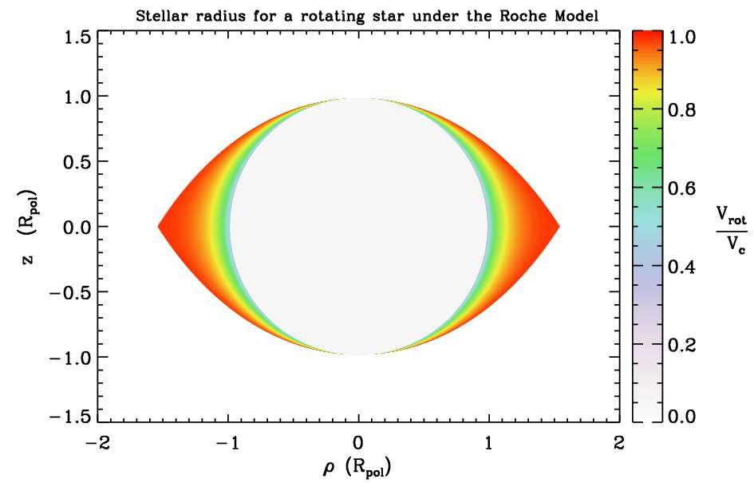
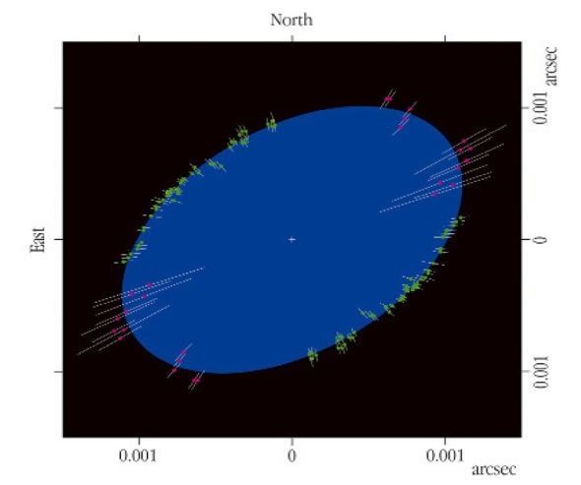
Massive Stars: Stellar Surfaces
Fast rotation: photosphere flattening
Measurements in the continuum
Spectral resolution: No
No resolving baselines
Visibility < 0.8
Maximum baselines
Multiple measurements
Ex : Achernar flattening
Domiciano de Souza et al. (2003)
Spec. Cl. | Diam. | Dist max | Nb *
B9 IV-V | 2.7 Ro | 150 pc | 131
B5 IV-V | 3.9 Ro | 210 pc | 33
B2 IV-V | 5.6 Ro | 300 pc | 51
O9 IV-V | 7.9 Ro | 450 pc | 96
Obs. with CHARA (B=330m pour V<0.8 ⬄ D>0.15mas)

Slide 8
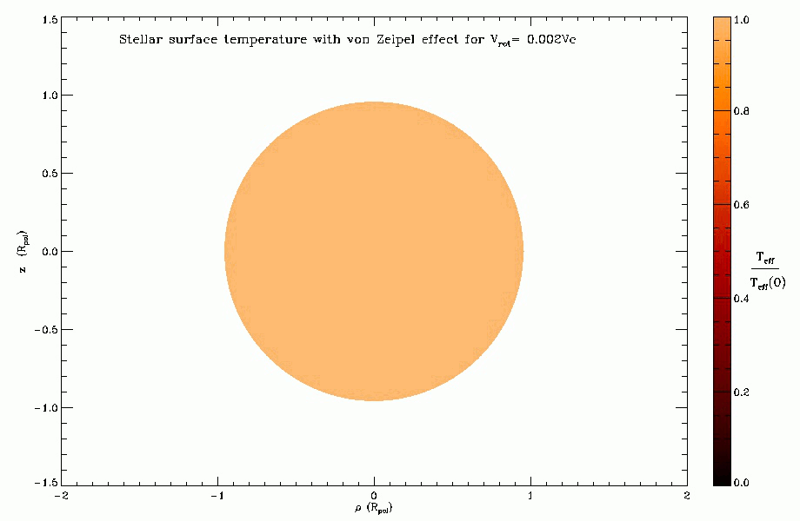
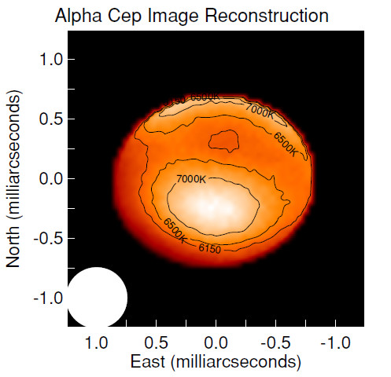
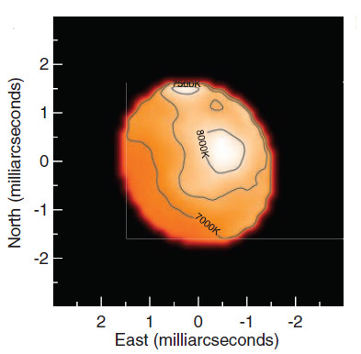
Massive Stars: Stellar Surfaces
Fast rotation: gravitational darkening
Alpha Cep
Altaïr
Zhao et al. (2009)
Monnier et al. (2007)
Measurements in the continuum or in lines
Spectral resolution: No
Resolving baselines(V ~ 0)
Second visibility lobe
Large Baselines
Phase closure
Image Reconstruction + model-fitting
Spec. Cl | Diam. | Dist max | Nb *
B9 IV-V | 2.7 Ro | 50 pc | 7
B5 IV-V | 3.9 Ro | 70 pc | 2
B2 IV-V | 5.6 Ro | 100 pc | 3
O9 IV-V | 7.9 Ro | 150 pc | 1
Obs. on CHARA (B=330m D>0.5mas)

Slide 9
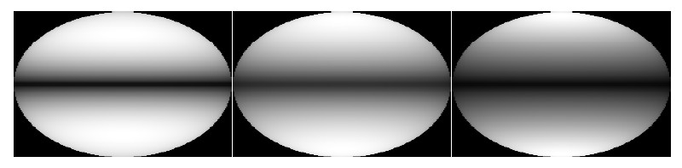
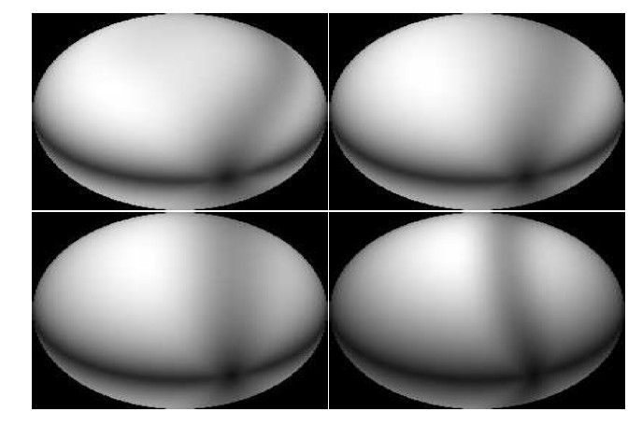
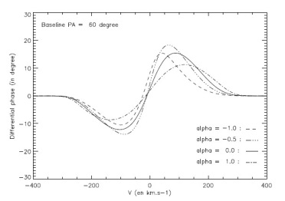
MASSIVE STARS: Stellar Surfaces
Fast rotation: differential rotation & gravitational darkening
In the continuum
In photospheric lines
Degeneracy between α et β
Delaa et al. (2013)
Multiple baselines per target
Precision on the phase of ≈ degres
R_{min} = 10000 (R_{opt}= 20000)
Limited by the spatial resolution !
Spec. Cl. | Diam. | Dist max | Nb *
B9 IV-V | 2.7 Ro | 50 pc | 7
B5 IV-V | 3.9 Ro | 70 pc | 2
B2 IV-V | 5.6 Ro | 100 pc | 3
O9 IV-V | 7.9 Ro | 150 pc | 1
Obs on CHARA (B=330m D>0.5mas et mV<4)

Slide 10
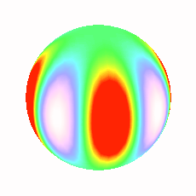
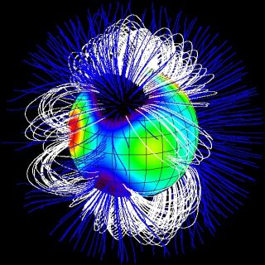
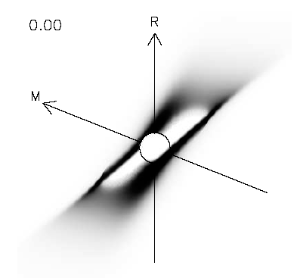
Massive Stars: Stellar activity
Pulsations
Importance of NRP in the Be phenomenon
Measurement in photospheric lines
S/N = 100
R > 15000 ⬄ 20km/s
Indirect measurement in emission lines
Magnetism
Direct measurement ?
Indirect measurement by the effect on the circumstellar environment
Stellar Spots
?
Yes
If convective zone due to fast rotation
Detectable ?

Slide 11
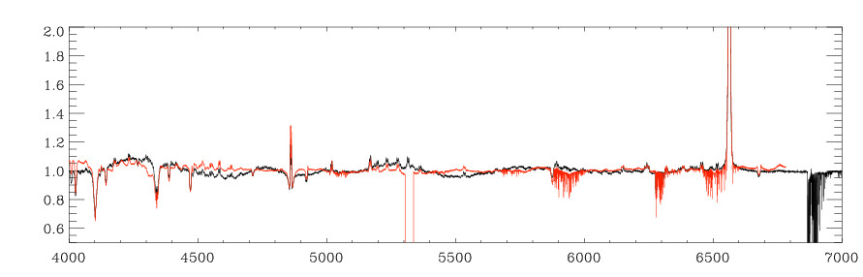
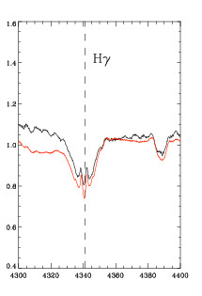
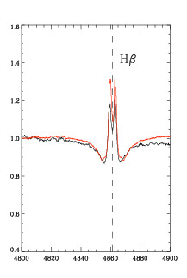
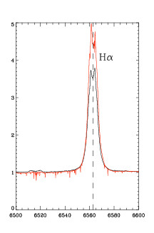
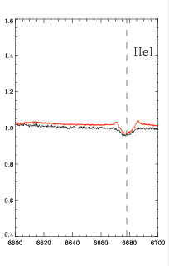
Massive Stars: circumstellar environments
Out of the Hα line
Visible Spectrum of the classical Be star Alpha Arae
Towards the blue domain
Atmospheric turbulence
Acces to faint lines
Precision <1% on diff. Vis.

Slide 12
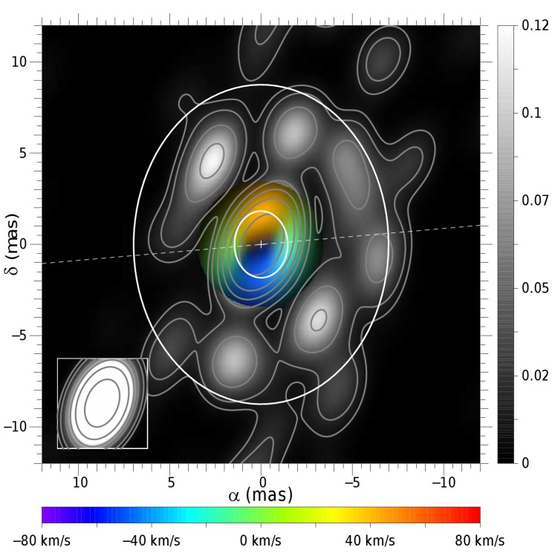
Massive stars: image reconstruction
Difficulities:
phase closure
Small vivibilities
In the V band the CE of masive stars are generally:
In the continuum:
Flux dominated by the central star
Need high precision for the measurements (1%)
In the emission lines:
Continuum mostly unresolved « Auto-calibration »
HD62623 : 3 nights with AMBER
Millour et al. 2011
Nb de tel. | 3T | 4T | 5T | 6T | 7T
Temps d’obs | 3n | 1.5n | 1n | 0.6n | 0.4n

Slide 13
Massive Stars: circumstellar environments
Many objects:
- Classical Be stars
- Supergiants and unclassified B[e]
- B & A supergiants
- Yellow hypergiants
- Wolf-Rayet
- Novae

Slide 14
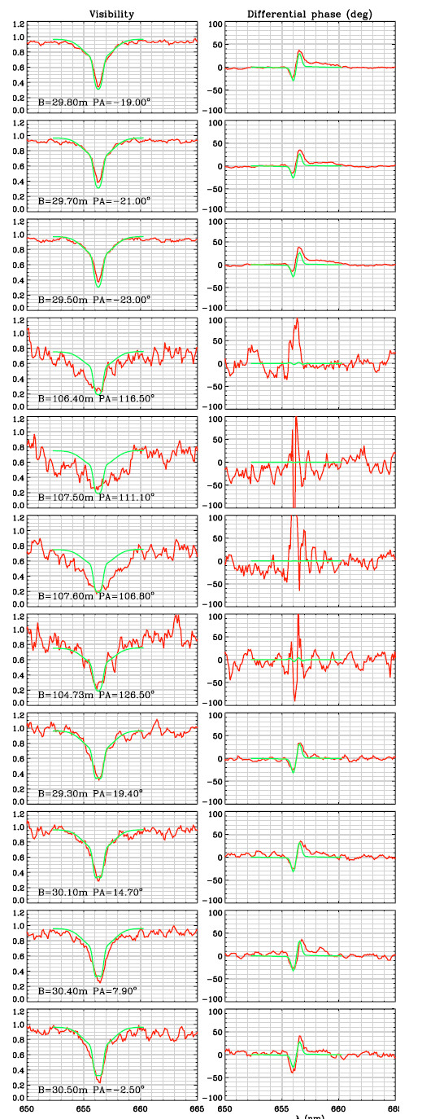
Massive stars: classical Be stars
γ Cas
Objectives :
Kinematics within different spectral lines
Link photosphere ⬄ environment
Be-Shell ⬄ i~90° ⬄ disk opening angle
Polar winds ?
Statistical studies
Variability (Pulsation & Binarity)
Modeling : ionization, Temperature, density
Needs :
R_{min} = 1500 ⬄ 200 km/s
R_{opt} = 15000 ⬄ 20 km/s
Short baselines (20-50m)
High precision for the visibilities : 1-2%
Faint visibilities (lines)
Magnitude is not a problem !
mV | 3 | 4 | 5 | 6
Nb of Stars | 11 | 23 | 59 | 102
Frémat et al. 2005
Stee et al. 2012

Slide 15
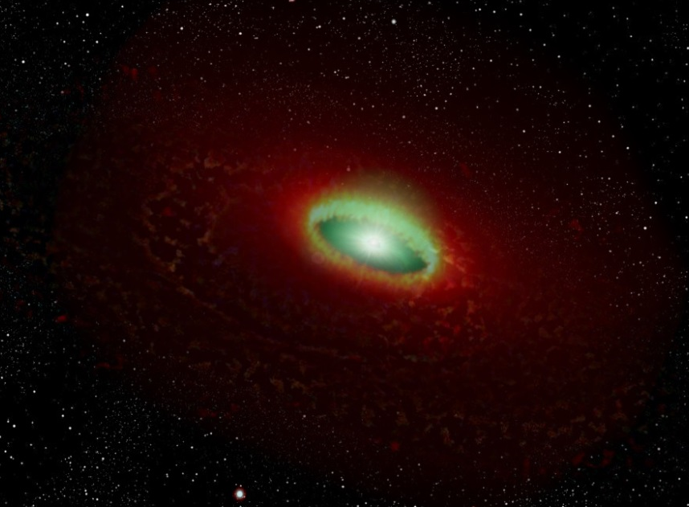

Massive stars: B[e]
Objectives :
Determine where the spectral lines are formed
Kinematics (disks vs winds)
Objects classification (young/evolved/binaries)
Variability (images as a function of time)
Needs :
R_{min} = 1500 ⬄ 200 km/s
R_{opt} = 15000 ⬄ 20 km/s
Objects mostly faint in V
HD62623
mV | 5 | 7 | 9
Nb of stars | 1 | 4 | 10
But non exhaustive list of targets
Millour et al. 2011

Slide 16
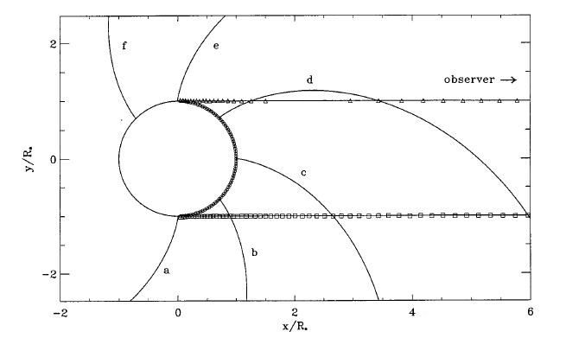
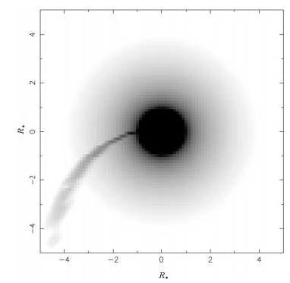
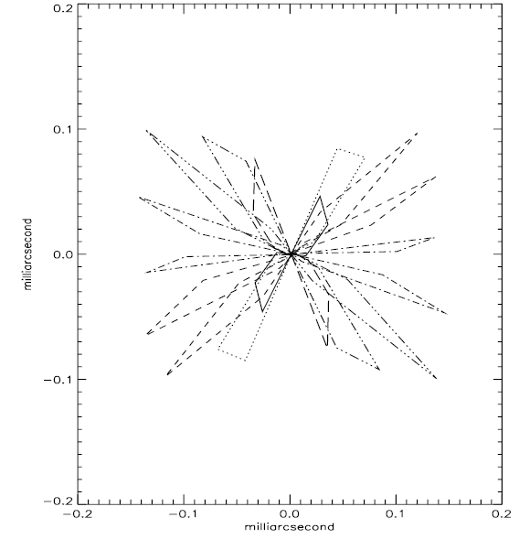
Massive stars: Corotating-Interacting regions
Pole-on view
Owocki, Cranmer and Fullerton, 1995
Harries et al. 1995
Origin of these perturbations?
Anchored magnetic fields
Non-Radial pulsations
+perturbation by fast rotation
Dessart & Chesneau 2002

Slide 17
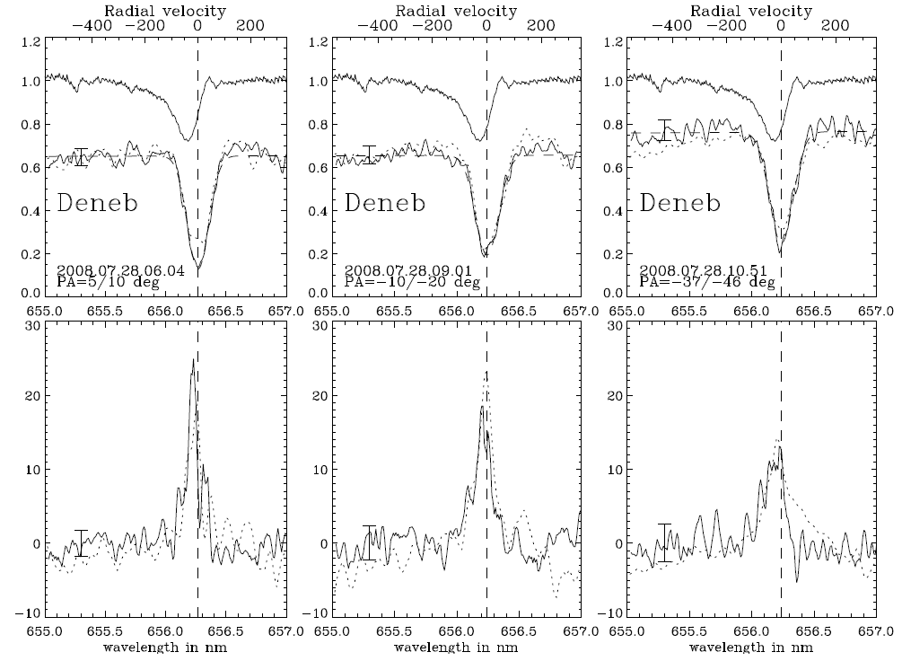
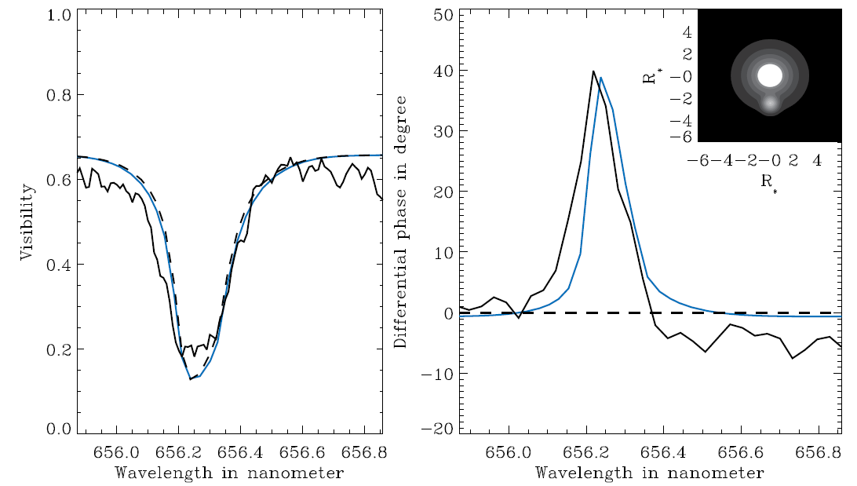
Massive stars: B & A supergiants
Objectives :
Diameters measurements
Extension in Hα (and other lines)
Mass loss
Asymmetry & time evolution
Problems :
Over-resolved with CHARA/VEGA
Solutions :
Concentrate on stars @ larger distances
Smaller baselines
Chesneau et al. 2010

Slide 18
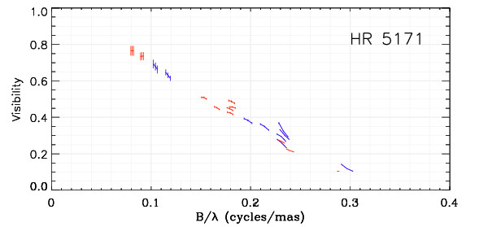

Massive stars: Yellow hypergiants
Objectives:
Constrain the geometry in the continuum
Study the instabilities in the atmosphere (spectral lines)
Constrain the rotation (pseudo-photosphere)
Companions detection and spectrum disentangling
Needs :
R = 30000 ⬄ 10km/s
mV = 5 (8)
A least 2 targets identified (Nord hemisphere):
ρ Cas
HR 8752
+ 2 objets with mV < 8
+ 5 in the South hemisphere
HR5191
Chesneau et al. (2014)
D=3.6kc, UD=3.6mas!
R*=1380 Rsol

Slide 19
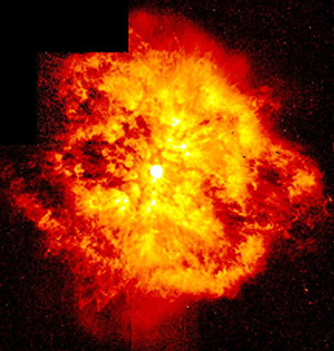
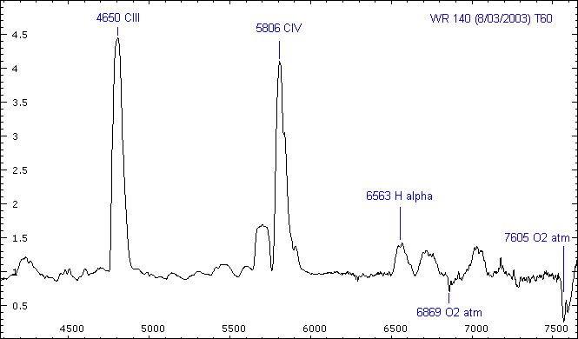
Massive stars: Wolf Rayet
Objectives :
Extension in spectral lines
Probing the ionization structure
Modeling the mass loss(Hillier & Dessart)
Study the binarity
Needs :
Large spectral lines ⬄ R = 1500 ⬄ 200 km/s
Objects faint in the visible (mV = 8)
Numerous and very bright emission lines
V=5.4
WR 140
mV=6.9

Slide 20
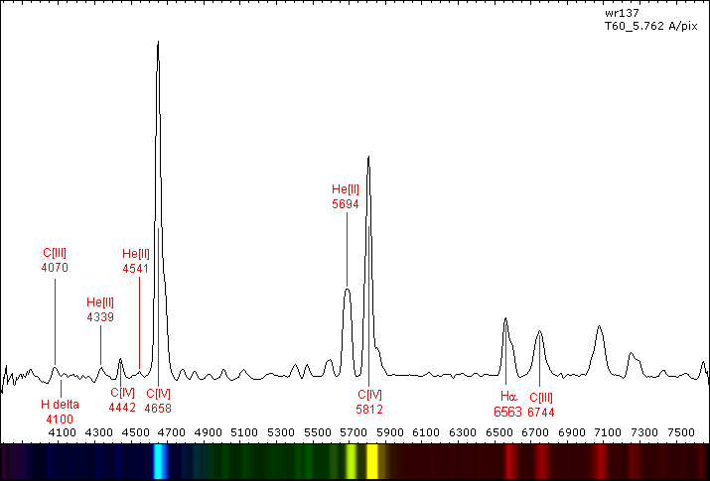
Massive stars: Wolf Rayet
6
gain
(2 mag)
WR 137
V=6.4
4
Cont.
V=7.9
Amateur spectrum

Slide 21
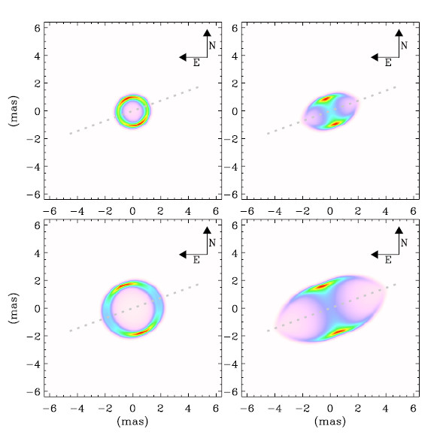
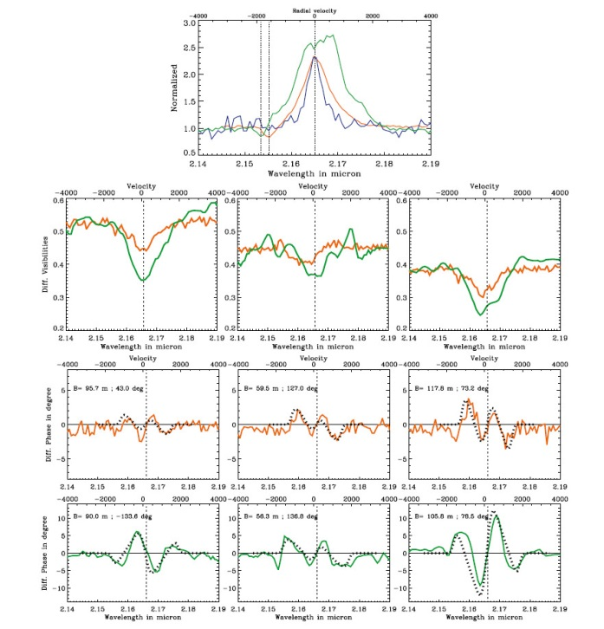
Massive stars: Novae
T Pyx observed withAMBER
Bright targets during a short period of time
Strong lines in emission
Rapid evolution of the circumstellar environment
Strong asymmetries developing
Reactivity + large number of baselines ⬄ spectro-imaging
Spectral resolution needed: at least 1500 ⬄ 200km/s
1970 FH Serpentis 4 mag
1975 V1500 Cygni 2.0 mag
1975 V373 Scuti 6 mag
1976 NQ Vulpeculae 6 mag
1978 V1668 Cygni 6 mag
1984 QU Vulpeculae 5.2 mag
1986 V842 Centauri 4.6 mag
1991 V838 Herculis 5.0 mag
1992 V1974 Cygni 4.2 mag
1999 V1494 Aquilae 5.0 mag
1999 V382 Velorum 2.6 mag
2006 RS Ophiuchi 4.5 mag
2007 V1280 Scorpii 3.7 mag
In 37 years
        13 novae with mV<6
        4 novae with mV<4
mV=8 ⬄ 1 nova / per year for VEGAS
Chesneau et al. 2011

Slide 22
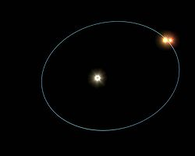
Massive stars: multiplicity
Why ?
Study of multiple systems provides accurate masses
Constraints on the formation of massive stars ?
1 mas
7-15 mas
How ?
Need long and short baselines simultaneously
=> Image is a must have !
“Super-synthesis” effect thanks to spectral resolution
Hierarchical triple system ξ Tau
Orbits: 7 & 145 days
Many targets up to V = 7

Slide 23
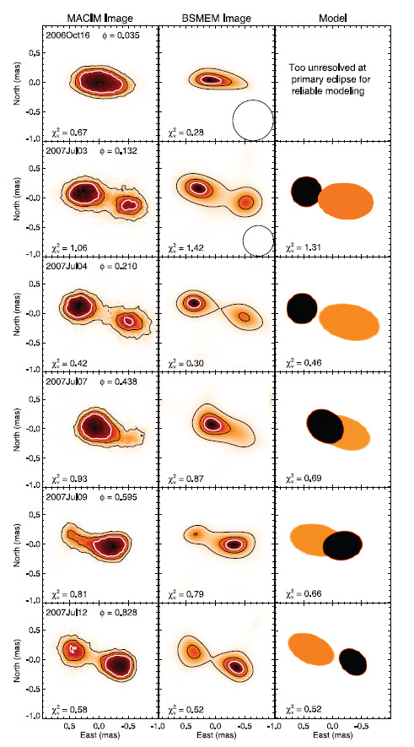
Massive stars: interaction
Images MIRC de β Lyr
X-Ray Be-binaries : Prototype β Lyr
D = 1 mas
T = 12.9 jours
- Perfectly suited for imaging with 300m baselines
- First convincing studies in the lines with VEGA
- First image with MIRC
Images in Continuum + Lines (Hα, Hβ & HeI)
Companion deformation
Spatial geometry of the ionized gaz
Gas kinematics
Physical conditions for the CE (T,ρ, ni)
Constraints on the mass loss
Other similar objects possible
Zhao et al. 2008

Slide 24
Massive stars: global specifications
Spectral modes : 2, 3 ou 4
HR1 : R=30000-40000 ⬄ 7-10 km/s ⬄ Pulsations, rotation, supergiants rotation
HR2 : R=10000-15000 ⬄ 20-30 km/s ⬄ Fast Rotation, disks & winds
MR : R=2000-5000 ⬄ 60-150 km/s ⬄ Wolf-Rayet, spectro faint CE
LR : R<500 ⬄ X ⬄ Stellar diameters, reddened sources
Sensibility :
mV = 5 for HR1
mV = 7 for HR2
mV = 9 for MR
mV = ? LR
Measurements accuracy:
Faint visibilities (stellar surfaces)
σ_{v} = few % in the continuum (Cont. Env.)
σ_{v}= few 0.1% in lines (Pulsations)
σ_{φ} = 1° in lines (Rotation/Pulsation)
Phase closure constraints
Number of telescopes:
At least 5 telescopes for 1 image/night
Short baselines mandatory (20-30m) and large (>300m) depending on the science objectives.

Slide 25
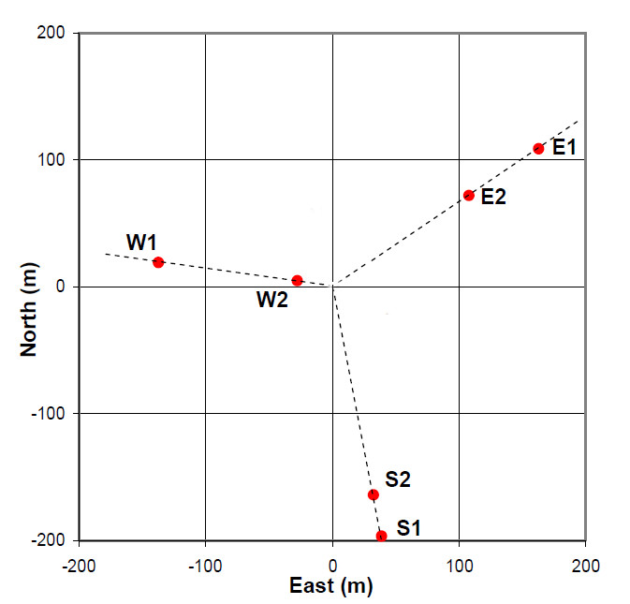
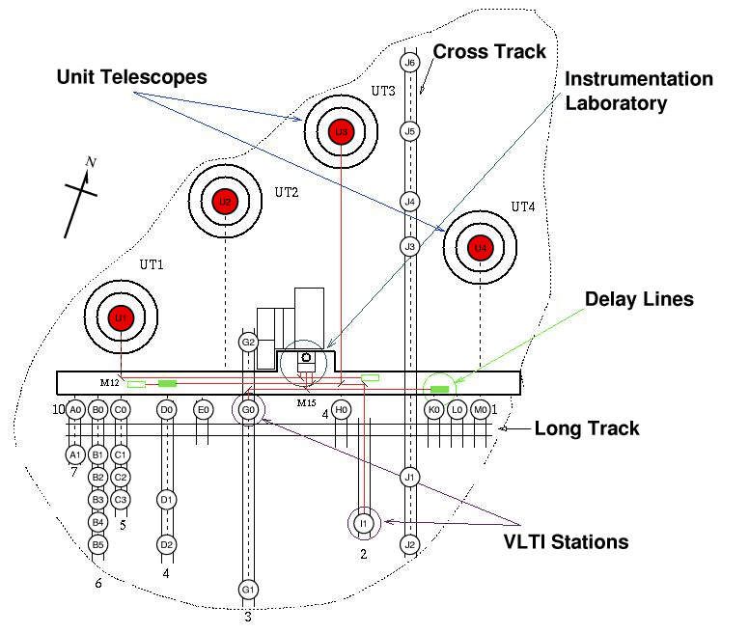
Where ?
CHARA
VLTI
Many short baselines (10-50m)
Large telescopes 8.2m (UT)
AT 1.6m = 1 more mag compared to CHARA
Maximum number of 4 telescopes
No large baselines ( > 200 m )
ESO organization ;-)
Many large baselines (330m)
Flexible organization
2 “small” baselines (34m & 66m)
Fixe telescopes
Only small telescopes
Stellar surfaces vs Circumstellar environments

Slide 26
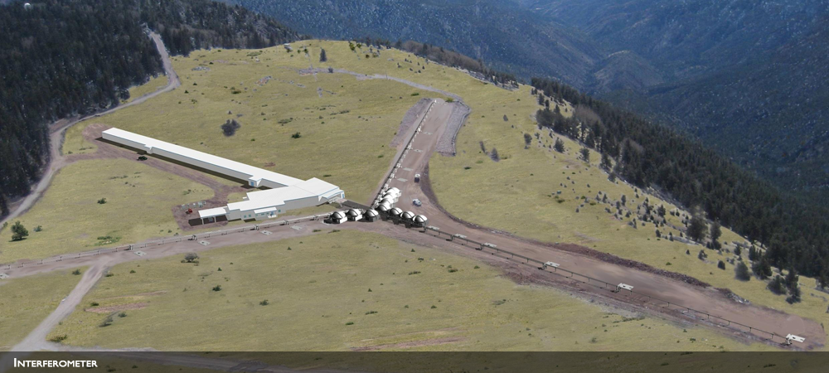
MROI ?
9 movable telescopes (1.4 m)
28 stations
Baselines from 8 to 340 m
Large or compact configurations possible

